Slide 1


GloboDiet: Overall internal structure
INTERNATIONAL AGENCY FOR RESEARCH ON CANCER LYON - FRANCE
e-SMP

Slide 2

GloboDiet: Overall internal structure
Foods
Composed recipes
Food Classification
Mixed recipes
Recipe Classification
GloboDiet training:
IARC, Lyon - France
Overall internal structure

Slide 3


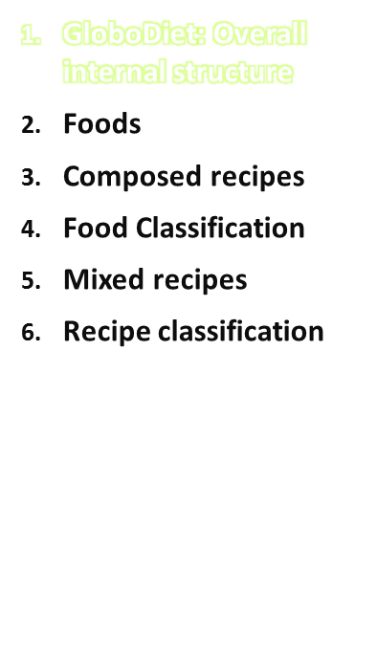
Selected Quick List Item
Food Pathway
Mixed Recipe
Pathway
Automatic search
Found in the food list ?
Found in the recipe list ?
Yes
No
Two main pathways
  Food pathway
  Recipe pathway
The same sequence of events during the interview (search, description, quantification, probe)
Describe
food
Describe
food
Quantify
food
Quantify
food
Probing
questions
Probing
questions
Notes
Overall internal structure
IARC, Lyon - France
GloboDiet training:

Slide 4
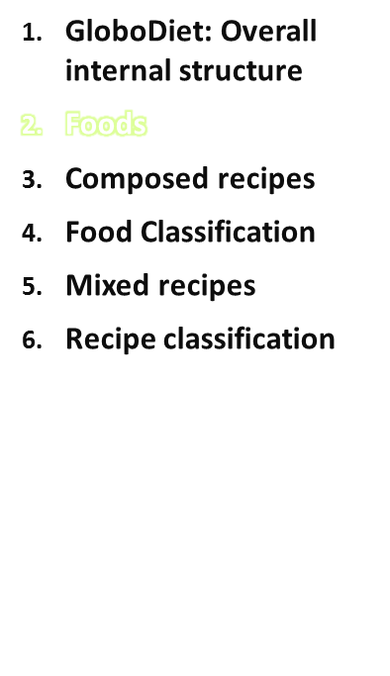

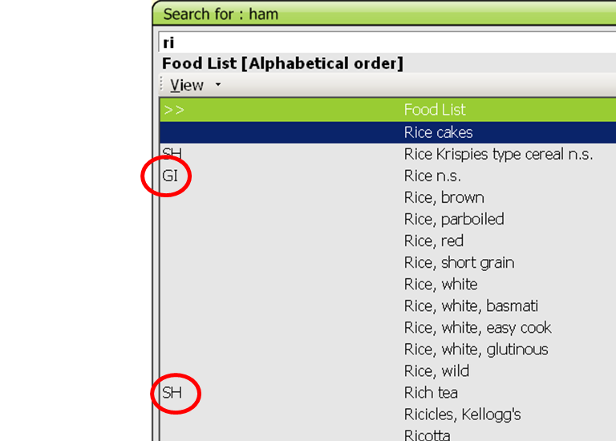
Named in a specific way: to ease the alphabetical search during the 24HR
e.g. ‘Rice, brown’ rather than ‘Brown rice’
Further details are added using facet-descriptors, starting from the food name (e.g. smoked, raw…)
Product names may be in the food list (e.g.Chocolates) or in the brand list
Generic items (GI) labeled with
‘n.s.’ (non specified) are available
in case the interviewee cannot
provide more detail e.g. ‘Rice n.s.’
Be familiar with
the local FDLIST
Overall internal structure
IARC, Lyon - France
GloboDiet training:

Slide 5
Foods
Shadow items (SH)
Alternative names = Synonyms
  e.g. ‘Rich tea’ is a synonym of ‘Biscuit, semi-sweet’
Alternative classification,
  e.g. ‘Brioche’ (classified in Cakes) may also appear under Breads
→ Be familiar with the local SHADOWLIST
Product names – Brand names
Not in the name but asked as additional information (facet)
Required to get information that might be coded afterwards, e.g. exact type of packaging plastic, fortification, alcohol content
New product and brand names can be entered during the interview
→Be familiar with the local BRAND list
Overall internal structure
IARC, Lyon - France
GloboDiet training:
Notes:
The Brandname list does not necessarily need to be printed for the interviewers

Slide 6
Foods
Be aware that the list of Brand names is the same for all foods included in the same subgroup
A new Brand name can be added and should apply to the following instructions:
  Order of description Brand name: Brand – product – taste info (e.g. aldi – ice cream - vanilla)
NOTE: New foods can be entered during the interview. The interviewer will enter their name and classification first. Then they will need to be described and quantified. The interviewer may/will enter further details or information into notes.
Overall internal structure
IARC, Lyon - France
GloboDiet training:

Slide 7
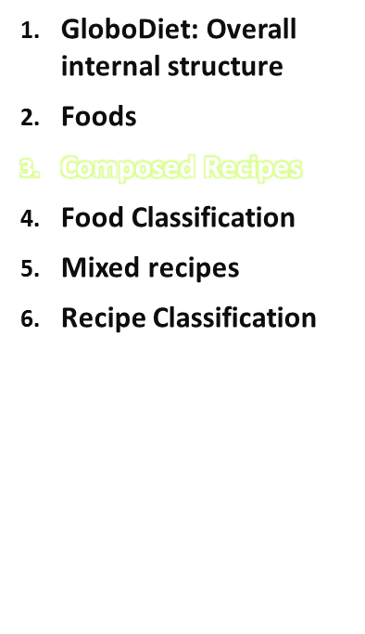
Definition: its different ingredients can be identified and quantified separately after preparation (e.g. meat balls in sauce, rice with sauce, couscous dish, mixed salad) or just before mixing (e.g. coffee with milk).
Composed recipes are built during the interview: there is no a priori list of composed recipes. They are made from items listed below/linked to a quick list item.
Overall internal structure
IARC, Lyon - France
GloboDiet training:

Slide 8
Composed recipes
Examples:
Coffee with milk
  Coffee
  Milk
  Sugar
Meat in sauce with rice
  Beef stew (is a recipe)
  Rice
Salad
  Lettuce
  Tomato
  Cucumber
  Salad dressing (can be a recipe in some projects where all sauces are in recipes)
Overall internal structure
IARC, Lyon - France
GloboDiet training:

Slide 9
Composed recipes
A composed recipe should be used even when some ingredients such as fat, sauce or sweetener cannot be quantified: standard percentages (PCTFSS) are in GloboDiet to avoid missing values
There is the possibility to have standard portions (e.g. for cheese or tuna) to be used to compose a mixed salad for example
→ to be planned when preparing local data (FDTSD)
Overall internal structure
IARC, Lyon - France
GloboDiet training:

Slide 10
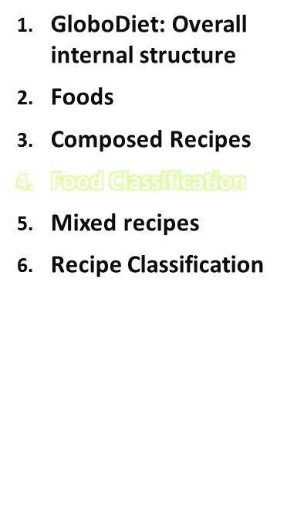
The food classification of GloboDiet is a methodological classification;
it is data-collection oriented and facilitates the food search during the interview.
It constitutes the backbone of the standardisation of interviews and cannot be changed.
Overall internal structure
IARC, Lyon - France
GloboDiet training:

Slide 11
Food classification
Food groups (# sub-(sub-)groups)
Unclassified (0)
Potato and other tubers (2)
Vegetables (9)
Legumes (2)
Fruits, nuts and seeds (4)
Dairy products and substitutes (19)
Cereals and products (9)
Meat, meat products and substitutes (20)
Fish, shellfish and amphibians (5)
Eggs and egg products (2)
Fats and oils (5)
Sugar and confectionary (4)
Cakes and sweet biscuits (3)
Non-alcohol beverages (10)
Alcoholic beverages (7)
Condiments, spices, sauces and yeast (9)
Soups and bouillons (3)
Miscellaneous (6)
Salty snacks (3)
Overall internal structure
IARC, Lyon - France
GloboDiet training:

Slide 12
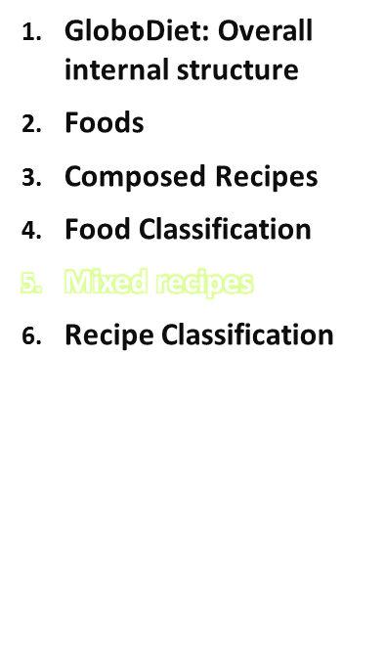
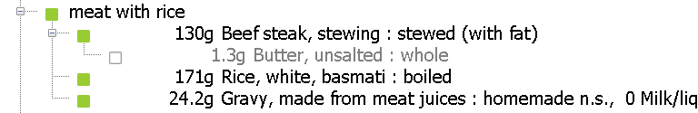
Mixed recipes are pre-entered in the Recipe Manager.
Characteristics of recipes:
The ingredient proportions are stable whatever the serving size
A unique quantification method is used for quantification.
Example: Meat with rice
If relative quantities change, then list and quantify rice and meat separately → create a composed recipe
Else a mixed recipe is perfect.
Overall internal structure
IARC, Lyon - France
GloboDiet training:

Slide 13
Mixed recipes
In the recipe list: there are several types of mixed recipes:
  OPEN: may be homemade or not.
  If homemade, may be known or not.
  OPEN WITH BRAND
  CLOSED: may be homemade or not
  CLOSED WITH BRAND
  STRICTLY COMMERCIAL WITH BRAND
  Substitute, Add, Delete
  Substitute
-
Stepwise binary questions
  In the food or recipe list?
  If recipe, Commercial or not?
  If homemade, Known by the subject or not?
If not found, new recipes can be created
  NEW: may be homemade or not. If homemade, may be known or not.
Substitute, Add, Delete
Overall internal structure
IARC, Lyon - France
GloboDiet training:

Slide 14
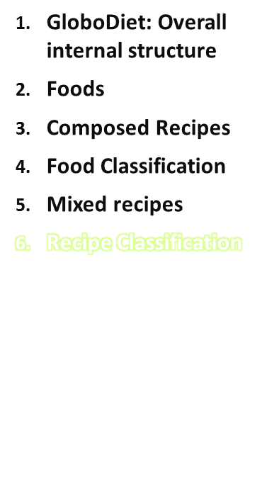
The recipe classification of GloboDiet is data-collection oriented, it might be used for searching.
Recipe groups (# sub-groups)
Based on meat and meat products (6)
Based on fish and crustaceans/molluscs (3)
Based on egg (0)
Based on cereal and cereal products (6)
Based on vegetables (incl. potatoes) (5)
Mixed beverages (0)
Soups (6)
Sweet recipes (5)
Sauces (0)
Other (0)
Overall internal structure
IARC, Lyon - France
GloboDiet training:

